Slide 1
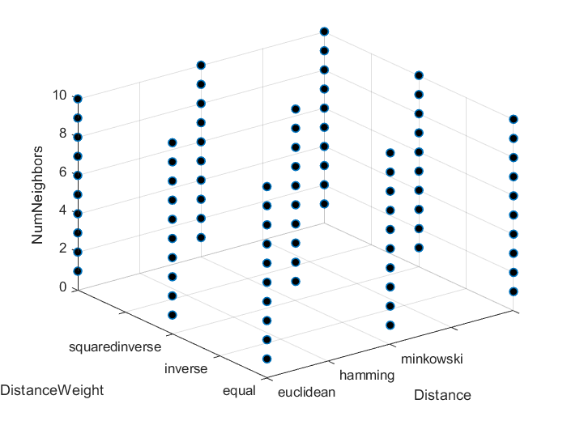
Hyperparameters Optimization

Slide 2
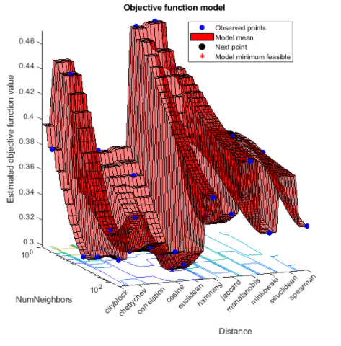
Performing Hyperparameters Optimization
Machine learning models present different properties that control how they work:
Number of neighbors in KNN classifier
Number of leaf node observations in classification tree
These properties are often called hyperparameters and can have a large impact on performance of a model
It’s typically time consuming or difficult to find the optimal hyperparameter values
Hyperparameters optimization allows to select a subset of the model's properties and find the optimal settings for a specific data set
Notes:
Model hyperparameters could have a large impact on performance.
The best hyperparameter values should be selected with a Hyperparameters optimization step.

Slide 3
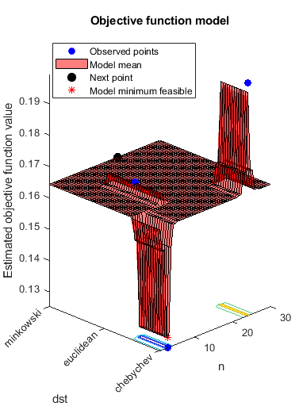
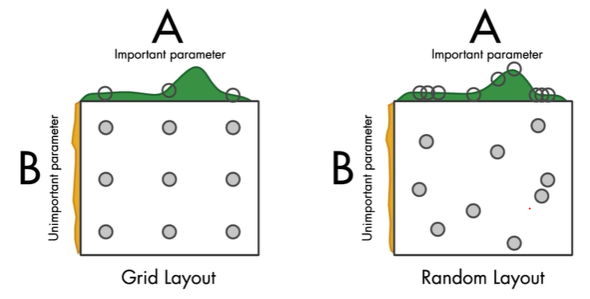
How to perform Hyperparameters Optimization?
1
Define a Search Space:
an n-dimensional volume, where each hyperparameter represents a different dimension
2
Select a search strategy:
Grid Search
Random Search
Bayesan Optimization
Notes:
Hyperparameters optimization consists of two steps:
Search space definition
Search strategy selection:
In Grid Search, every hyperparameter configuration is explored.
In Random Search, the search space is randomly sampled.
The Bayesian optimization exploits the information obtained in the previous evaluations of the hyperparameters to determine which is the next point in the search space to be explored. It makes use of an acquisition function to determine the next point to evaluate.

Slide 4
Search strategies
Grid search is easy to understand but requires a quite long computation
Random search has become more popular than grid search:
There is a much better chance of finding a good value for an hyperparameter the model is sensitive to (video)
The Bayesian optimization considers how hyperparameters values affect model results:
It exploits the information obtained in the previous evaluations of the hyperparameters to determine which is the next point in the search space to be explored
Grid Search
Random Search
Notes:
- Since Grid Search explores every hyperparameter configuration, it requires a quite long computation
Let’s imagine you have 2 hyperparameters, “A” and “B”. Your model is very sensitive to “A,” but not sensitive to “B.” If we did a 3x3 grid search, we would only ever evaluate 3 different values of “A.” But if we did a random search, we would probably get 9 different values of “A”, even though some may be close together. As a result, we have a much better chance of finding a good value for “A.” In machine learning, we often have many hyperparameters. Some have a big influence over the results, and some don’t. So random search is typically a better choice.
The Bayesian optimization considers how hyperparameters values affect model results

